Slide 1
Lecture 5 Search

Slide 2

The search example
State space S: all valid configurations
Initial states (nodes) I = {(CSDF,)} ⊆ S
Where’s the boat?
Goal states G = {(,CSDF)} ⊆ S
Successor function succs(s) ⊆ S: states reachable in one step (one arc) from s
succs((CSDF,)) = {(CD, SF)}
succs((CDF,S)) = {(CD,FS), (D,CFS), (C, DFS)}
cost(s,s’) = 1 for all arcs. (weighted later)
The search problem: find a solution path from a state in I to a state in G.
Optionally minimize the cost of the solution.

Slide 3

The search example
Water jugs: how to get 1?
Goal? (How many goal states?)
Successor function: fill up (from tap or other jug), empty (to ground or other jug)

Slide 4
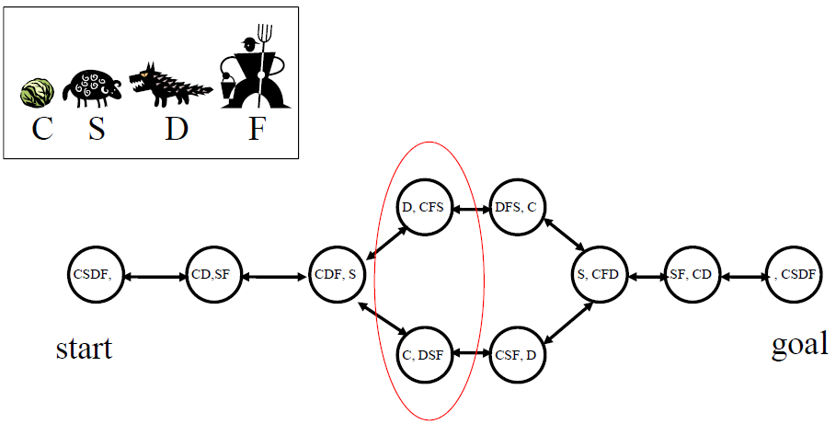
A directed graph in state space
In general there will be many generated, but un-expanded states at any given time
One has to choose which one to expand next
Deep or shallow?

Slide 5
Uninformed search
Uninformed means we only know:
The goal test
The succs() function
But not which non-goal states are better: that would be informed search.
For now, we also assume succs() graph is a tree.
Won’t encounter repeated states.
We will discuss it later.
Search strategies: BFS, UCS, DFS, IDS.

Slide 6
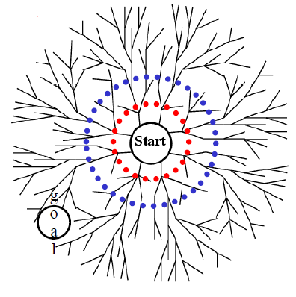
Breadth-first search (BFS)
Use a queue (First-in First-out)
en_queue(Initial states)
While (queue not empty)
s = de_queue()
if (s==goal) success!
T = succs(s)
for t in T: t.prev=s
en_queue(T)
endWhile
We need back pointers to recover the solution path.

Slide 7
Performance of BFS
Assume:
the graph may be infinite.
Goal(s) exists and is only finite steps away.
Will BFS find at least one goal?
Will BFS find the least cost goal?
Time complexity?
Number of states generated
Goal: d edges away
Branching factor: b
Space complexity?
Number of states stored

Slide 8
Performance of BFS
Completeness: yes, BFS will find a goal.
Optimality: yes, if edges cost 1 (more generally positive non-decreasing in depth), no otherwise.
Time complexity (worst case): goal is the last node at radius d.
Have to generate all nodes at radius d.
b + b² + … + b^{d} ~ O(b^{d})
Space complexity: O(b^{d})

Slide 9
Uniform-cost search
Find the least-cost goal
Each node has a path cost from start (= sum of edge costs along the path). Expand the least cost node first.
Use a priority queue instead of a normal queue
Always take out the least cost item
Remember heap? time O(log(number of items in heap))
Complete and optimal (if edge costs >= ε > 0)
Time and space: can be much worse than BFS
Let C* be the cost of the least-cost goal
O(b^{C*/ ε}), possibly C*/ ε >> d

Slide 10
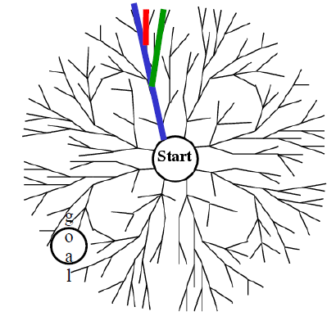
Depth-first search
Use a stack (First-in Last-out)
push(Initial states)
While (stack not empty)
s = pop()
if (s==goal) success!
T = succs(s)
push(T)
endWhile
This is non-recursive implementation of DFS, recursive implementation is more common

Slide 11
Performance of DFS
m = maximum depth of graph from start
Space complexity: O(mb)
Infinite tree: may not find goal (incomplete)
May not be optimal
Finite tree: may visit almost all nodes, time complexity O(b^{m})

Slide 12
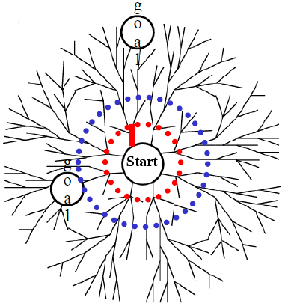
Iterative deepening search
1. DFS, but stop if path length > 1.
2. If goal not found, repeat DFS, stop if path length >2.
3. And so on…

Slide 13
Iterative deepening search
BFS + DFS
Complete, optimal like BFS
Small space complexity like DFS
•A huge waste?
Each deepening repeats DFS from the beginning
No! db+(d-1)b²+(d-2)b³+…+b^{d} ~ O(b^{d})
Time complexity like BFS

Slide 14
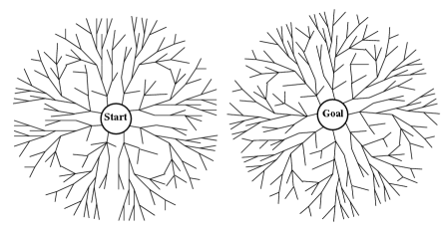
Bidirectional search
Breadth-first search from both start and goal
Stop when fringes meet
The fringes(边缘) are O(b^{d/2})
Generates O(b^{d/2}) instead of O(b^{d}) nodes

Slide 15
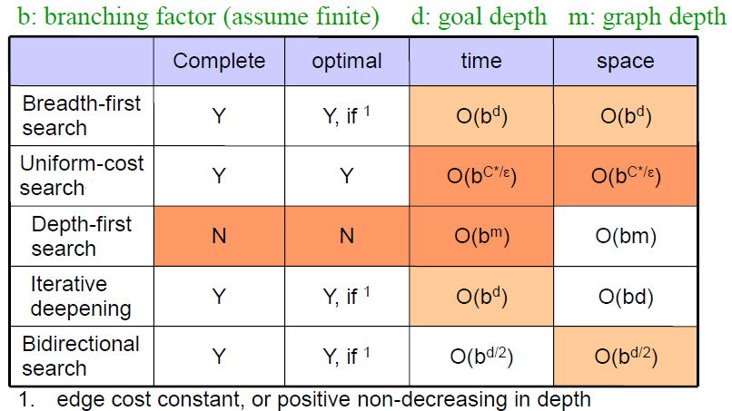
Performance of search algorithms

Slide 16
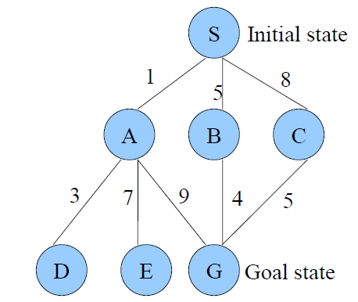
Search example
All edges are directed, pointing downwards

Slide 17
Node expansion
Depth-First Search:
S A D E G
Solution found: S A G
Breadth-First Search:
S A B C D E G
Solution found: S A G
Uniform-Cost Search:
S A D B C E G
Solution found: S B G (This is the only uninformed search that worries about costs.)
Iterative-Deepening Search:
S A B C S A D E G
Solution found: S A G

Slide 18
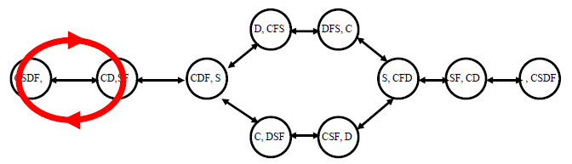
General graph search
The problem: repeated states
We have to remember already-expanded states (CLOSED).
When we take out a state from the fringe (OPEN), check whether it is in CLOSED (already expanded).
If yes, throw it away.
If no, expand it (add successors to OPEN), and move it to CLOSED.

Slide 19
General graph search
BFS:
Still O(b^{d}) space complexity
DFS:
Memorizing DFS (MEMDFS): memorize every expanded states
Path Check DFS (PCDFS): remember only expanded states on current path (from start to the current node)

Slide 20


Informed search
Uninformed search
Knows the actual path cost g(s) from the start to a node s.
Informed search
Also has a heuristic h(s) of the cost from s to goal.
Can be much faster than uninformed search.

Slide 21
Recall: Uniform-cost search
Uniform-cost search: uninformed search when edge costs are not the same.
Complete (will find a goal). Optimal (will find the least-cost goal).
Always expand the node with the least g(s)
Use a priority queue:
Push in states with their first-half-cost g(s)
Pop out the state with the least g(s) first
Now we have an estimate of the second-half-cost h(s), how to use it?

Slide 22
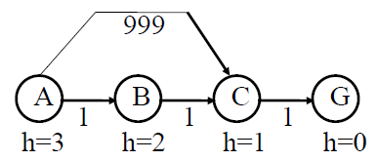
Best-first greedy search
Use h(s) instead of g(s)
Always expand the node with the least h(s)
Not optimal
It will follow the path A -> C -> G

Slide 23
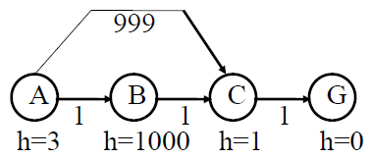
A search
Use f(s)=g(s)+h(s)
Always expand the node with the least g(s)+h(s)
A search is not always optimal

Slide 24
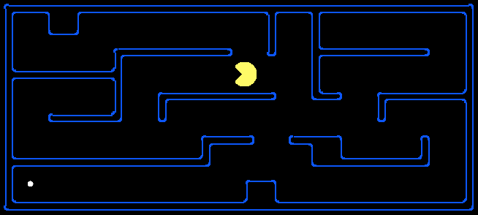
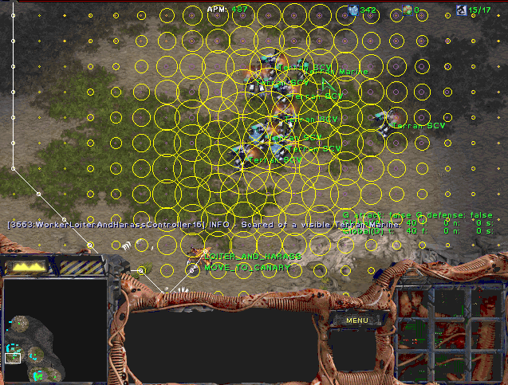
A* search
Same as A search, but the heuristic function h() has to satisfy h(s)<=h*(s), where h*(s) is the true cost from node s to the goal.
Such heuristic function h() is called admissible.
An admissible heuristic never over-estimates
A search with admissible h() is called A* search.

Slide 25
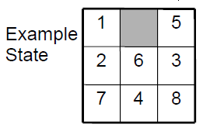
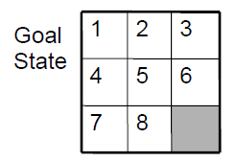
Admissible heuristic functions h
8-puzzle example
Which of the following are admissible heuristics?
h(n)=number of tiles in wrong position
h(n)=0
h(n)=1
h(n)=sum of Manhattan distance between each tile and its goal location

Slide 26
Admissible heuristics
A heuristic function h₂ dominates h₁ if for all s
h₁(s) <= h₂(s) <= h*(s)
d = 14,
A*(h₁) = 539 nodes
A*(h₂) = 113 nodes
d = 24,
A*(h₁) = 39,135 nodes
A*(h₂) = 1,641 nodes
We prefer heuristic functions as close to h* as possible, but not over h*.
Good heuristic function might need complex computation
Time may be better spent, if we use a faster, simpler heuristic function and expand more nodes.

Slide 27
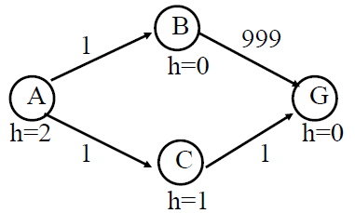
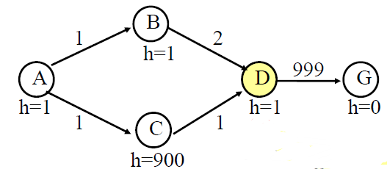
Some tricks
A* should terminate only when a goal is popped from the priority queue
A* can revisit an expanded state, and discover a shorter path

Slide 28
The A* algorithm
1.Put the start node S on the priority queue, called OPEN
2.If OPEN is empty, exit with failure
3.Remove from OPEN and place on CLOSED a node n for which f(n) is minimum
4.If n is a goal node, exit (trace back pointers from n to S)
5.Expand n, generating all its successors and attach to them pointers back to n. For each successor n' of n not on CLOSED
1.If n' is not already on OPEN, estimate h(n'),g(n')=g(n)+c(n,n'), f(n')=g(n')+h(n'), and place it on OPEN.
2.If n' is already on OPEN, then check if g(n') is lower for the new version of n'. If so, then:
Redirect pointers backward from n' along path yielding lower g(n').
Put n' on OPEN.
If g(n') is not lower for the new version, do nothing.
6.Goto 2.

Slide 29
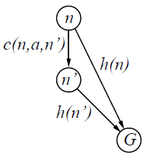
Consistent heuristics
Consistency is analogous to the triangle inequality from Euclidian geometry.
A heuristic is consistent if
h(n) <= c(n, a, n’) + h(n’)
If h is consistent, then for
every child n’ of n, we have:
f(n’) = g(n’) + h(n’)
= g(n) + c(n, a, n’) + h(n’)
>= g(n) + h(n)
= f(n)
That is, f(n) is non-decreasing along any path.

Slide 30
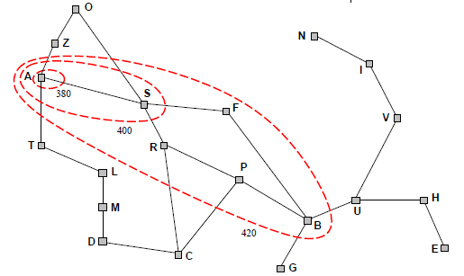
Behavior of A* with consistent heuristic
If h is consistent, then A* expands nodes in order of increasing f value. In such a case, A* can be implemented more efficiently — no node needs to be processed more than once.
Gradually adds “f-contours" of nodes (breadth-first adds layers)
Contour i has all nodes with f = f_{i}, where f_{i} < f_{i+1}

Slide 31
Properties of A*
Complete? Yes
Time? O(entire state space) in worst case, O(d) in best case
Space? Keeps all nodes in memory
Optimal? Yes

Slide 32
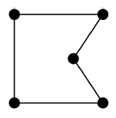
Traveling salesman problem
For a node s
f(s)=g(s)+h(s)
What is g(s), h(s)?
A* v.s. branch-and-bound

Slide 33
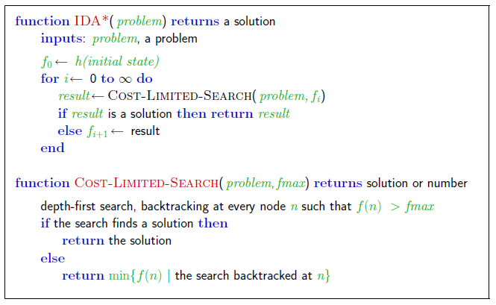
Iterative-Deepening A*

Slide 34

Thank you!

